Slide 1

DATA STRUCTURES USED IN
SOCIAL NETWORKING

Slide 2
OUR GROUP MEMBERS
S.no | NAME | ROLL NO.
1 | Jayveer Khandelwal | 222034
2 | Kiran Musale | 222035
3 | Kirtan Bhat | 222036
4 | Kirti Singh | 222037
5 | Parimal Kodape | 222038

Slide 3
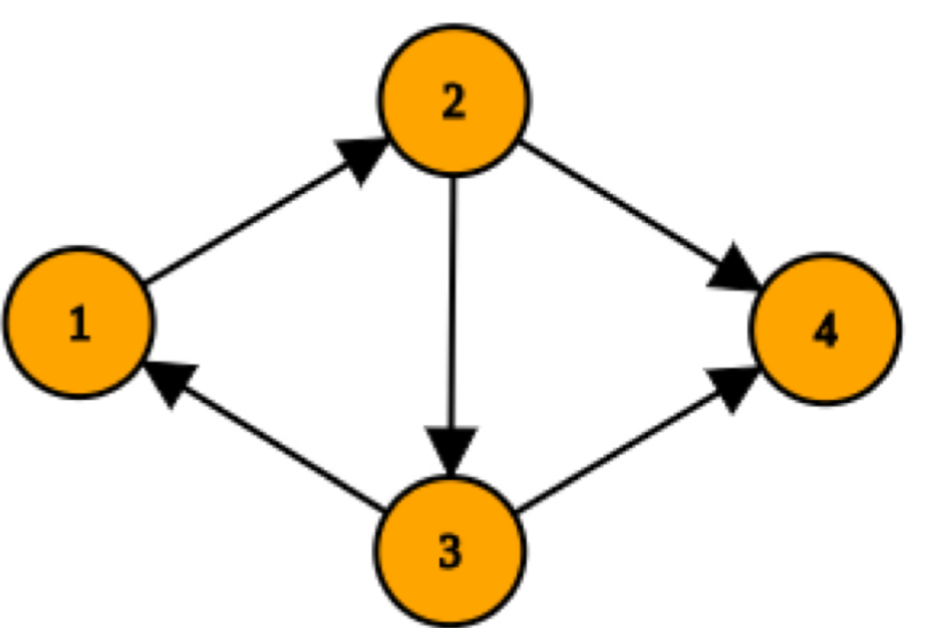
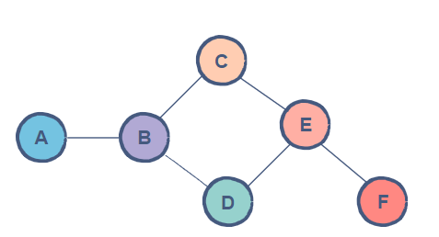
WHAT IS A GRAPH?
A graph represents a network that consists of a set of objects, mathematically called vertices or nodes.
Graphs can be classified into two types based on types of edges: -
DIRECTED GRAPH
UNDIRECTED GRAPH

Slide 4
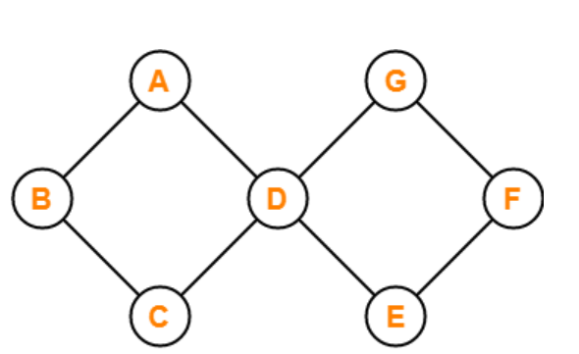
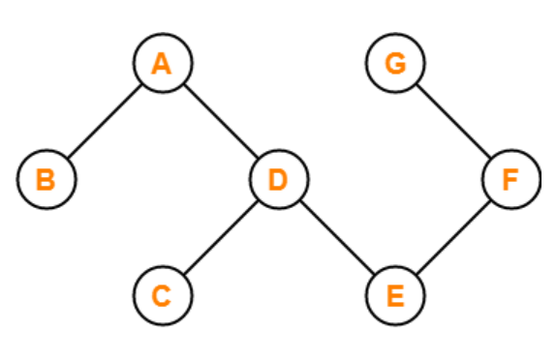
A Graph can again be classified based on the presence or absence of cycles formed in the graph: -
CYCLIC GRAPH
ACYCLIC GRAPH

Slide 5
ADJACENCY MATRICES
M → Square matrix.
n → number of vertices present in the graph.
If Mij = 1, it means there is an edge connecting vertex i and vertex j.
If Mij = 0, it means there is no edge connecting vertex i and vertex j.
6
1
5
 | 1 | 2 | 3 | 4 | 5 | 6
1 | 0 | 1 | 0 | 0 | 1 | 0
2 | 1 | 0 | 1 | 0 | 1 | 0
3 | 0 | 1 | 0 | 1 | 0 | 0
4 | 0 | 0 | 1 | 0 | 1 | 1
5 | 1 | 1 | 0 | 1 | 0 | 0
6 | 0 | 0 | 0 | 1 | 0 | 0
4
2
3

Slide 6
ADJACENCY LIST
In this case, all the zeroes of the adjacency matrix are eliminated and only the corresponding neighboring nodes of a particular node are considered.
 | 1 | 2 | 3 | 4 | 5 | 6
1 | 0 | 1 | 0 | 0 | 1 | 0
2 | 1 | 0 | 1 | 0 | 1 | 0
3 | 0 | 1 | 0 | 1 | 0 | 0
4 | 0 | 0 | 1 | 0 | 1 | 1
5 | 1 | 1 | 0 | 1 | 0 | 0
6 | 0 | 0 | 0 | 1 | 0 | 0
Neighboring nodes of 1: 2,5
Neighboring nodes of 2: 1,3, and 5
Neighboring nodes of 3: 2,4
Neighboring nodes of 4: 3,5, and 6
Neighboring nodes of 5: 1,2, and 4
Neighboring nodes of 6: 4.

Slide 7

GRAPH THEORY AND SOCIAL MEDIA
SOCIAL GRAPHS
A social graph is a diagram that illustrates interconnections among people, groups, and organizations in a social network. The term is also used to describe an individual's social network.
GRAPH THEORY IN FACEBOOK
The concept of graph theory is used in Facebook with each person as a node, and every like, tag, share, comment as edges.
GRAPH THEORY IN TWITTER
The persons are considered nodes and if one person follows another then there is considered an edge between the two.

Slide 8
HOW CAN WE DESIGN THE DATA STRUCTURES FOR A VERY LARGE SOCIAL NETWORK LIKE
FACEBOOK OR LINKEDIN..?
APPROACH →
We can construct a graph by treating each person as a node and letting an edge between two nodes indicate that the two users are friends. If we want to find the path between two people, we start with one person and do a breadth-first search.
Alternatively, we can do the bidirectional breadth-first search. This means doing two breadth-first searches, one from the source and one from the destination. When the searches collide, we know we’ve found a path.
TIME COMPLEXITY → O(V + E) when adjacency list is used
O(V^2) when adjacency matrix is used.
IS THERE ANY OTHER APPROACH…?

Slide 9

REFERENCES
Application of Graph theory in Social media- JCSE research paper
Design the data structure for large social network | Runhe Tian Coding Practice (wordpress.com)
Design data structures for a very large social network like Facebook or Linkedln – GeeksforGeeks

